Slide 1
Subspace
Hung-yi Lee
Notes:
Think:
beginning
subspace

Slide 2
In Chapter 4 ……
民濕寢則腰疾偏死，鰌然乎哉？木處則惴慄恂懼，猨猴然乎哉？三者孰知正處？民食芻豢，麋鹿食薦，蝍蛆甘帶，鴟鴉嗜鼠，四者孰知正味？猨猵狙以為雌，麋與鹿交，鰌與魚游。毛嬙、西施，人之所美也；魚見之深入，鳥見之高飛，麋鹿見之決驟，四者孰知天下之正色哉？《莊子‧齊物論》
The same vector or operation is represented differently when they are in different coordinate systems.
Notes:
ㄑ一ㄡ
ㄆㄧㄢˋ ㄐㄩ
除 換
神話傳說中的野獸。形似猿猴。《莊子．齊物論》：「猨，猵狙以為雌。」

Slide 3
Subspace

Slide 4
Reference
Textbook: chapter 4.1

Slide 5
Subspace
A vector set V is called a subspace if it has the following three properties:
1. The zero vector 0 belongs to V
2. If u and w belong to V, then u+w belongs to V
3. If u belongs to V, and c is a scalar, then cu belongs to V
Closed under (vector) addition
Closed under scalar multiplication
2+3 is linear combination
Notes:
1. Is kind of redundent

Slide 6
Examples
Subspace?
Property 1. 0 ∈ W
6(0) − 5(0) + 4(0) = 0
Property 2. u, v ∈ W ⇒ u+v ∈ W
u = [ u₁ u₂ u₃ ]^{T}, v = [ v₁ v₂ v₃ ]^{T}
u+v=[ u₁+v₁ u₂+v₁ u₃+v₁ ]^{T}
6(u₁+v₁) − 5(u₂+v₂) + 4(u₃+v₃)
= (6u₁ − 5u₂ + 4u₃ ) + (6v₁ − 5v₂ + 4v₃ )
= 0 + 0 = 0
Property 3. u ∈ W ⇒ cu ∈ W
6(cu₁) − 5(cu₂) + 4(cu₃)
= c(6u₁ − 5u₂ + 4u₃)
= c0 = 0

Slide 7
Examples
V = {cw | c ∈ R}
Subspace?
Subspace?
u ∈ S₁, u ≠ 0 ⇒ −u ∉ S₁
Subspace?
R^{n}
Subspace?
{0}
Subspace?
zero subspace

Slide 8
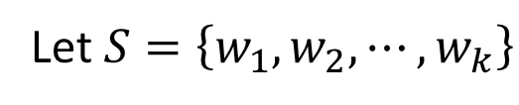
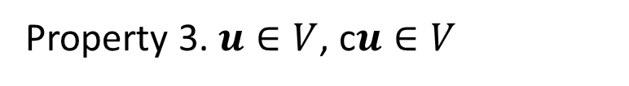
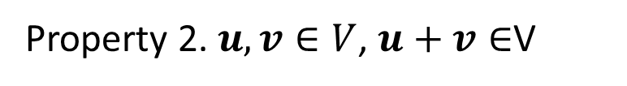
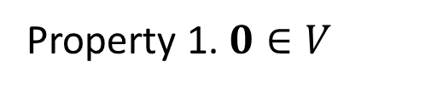

Subspace v.s. Span
The span of a vector set is a subspace
Let $S=\left\{w_{1},w_{2},⋯,w_{k}\right\}$
$$V=Span S$$
Property 1. $0∈V$
Property 2. $u,v∈V$, $u+v∈$V
Property 3. $u∈V$, c$u∈V$
Span
Subspace
Next lecture
Notes:
S = {w₁, w₂, …, w_{k}}.
0 = 0w₁ + 0w₂ + ☹ + 0w_{k} ∈ SpanS ;
u = a₁w₁ + a₂w₂ + ☹ + a_{k}w_{k}, v = b₁w₁ + b₂w₂ + ☹ + b_{k}w_{k},
⇒ u + v = (a₁+b₁)w₁ + (a₂+b₂)w₂ + ☹ + (a_{k}+b_{k})w_{k} ∈ SpanS ,
cu = ca₁w₁ + ca₂w₂ + ☹ + ca_{k}w_{k} ∈ SpanS .

Slide 9
Null Space
The null space of a matrix A is the solution set of Ax=0. It is denoted as Null A.
Null A is a subspace
Null A = { v ∈ R^{n} : Av = 0 }
The solution set of the homogeneous linear equations Av = 0.
A linear function is one-to-one
Null space only contain 0
Notes:
某個線性 function 得值域

Slide 10
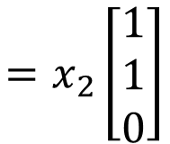
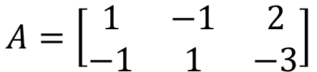
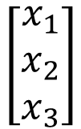

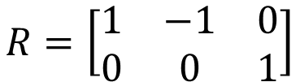
Null Space - Example
Find a generating set for the null space of T.
The null space of T is the set of solutions to Ax = 0
$$A=\left[\begin{matrix}1 & −1 & 2 \\ −1 & 1 & −3\end{matrix}\right]$$
$$R=\left[\begin{matrix}1 & −1 & 0 \\ 0 & 0 & 1\end{matrix}\right]$$
$$x_{1}=x_{2}$$
$$\left[\begin{matrix}x_{1} \\ x_{2} \\ x_{3}\end{matrix}\right]$$
$$=x_{2}\left[\begin{matrix}1 \\ 1 \\ 0\end{matrix}\right]$$
a generating set for the null space

Slide 11

Column Space and Row Space
Column space of a matrix A is the span of its columns. It is denoted as Col A.
Row space of a matrix A is the span of its rows. It is denoted as Row A.
If matrix A represents a function
Col A is the range of the function

Slide 12
Column Space = Range
The range of a linear transformation is the same as the column space of its matrix.
Linear Transformation
Standard matrix
⇒ Range of T =

Slide 13


RREF
Original Matrix A v.s. its RREF R
Columns:
The relations between the columns are the same.
The span of the columns are different.
Rows:
The relations between the rows are changed.
The span of the rows are the same.
$$Col A ≠Col R$$
$$Row A=Row R$$

Slide 14
Consistent
Ax = b have solution (consistent)
b is the linear combination of columns of A
b is in the span of the columns of A
b is in Col A
Solving Ax = u
Solving Ax = v
RREF([A u]) =
RREF([A v]) =

Slide 15
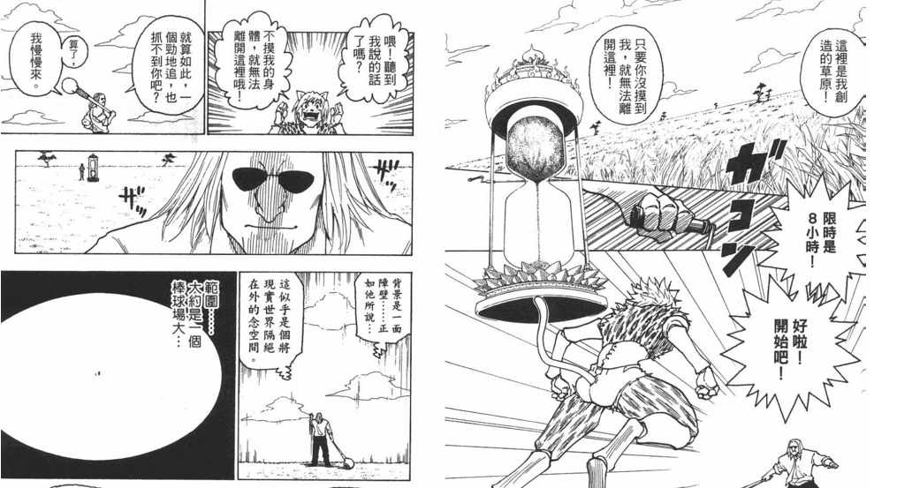
Conclusion: Subspace is Closed under addition and multiplication
Notes:
基度

